Slide 1

Digital Design
With an Introduction to the Verilog HDL, VHDL, and SystemVerilog
6th Edition, Global Edition
Chapter 05
Synchronous Sequential Logic

Slide 2
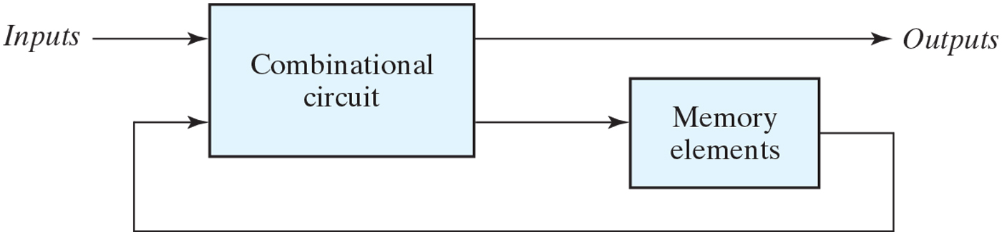
Block diagram of sequential circuit
Outputs are function of inputs and present states
Present states are supplied by memory elements

Slide 3
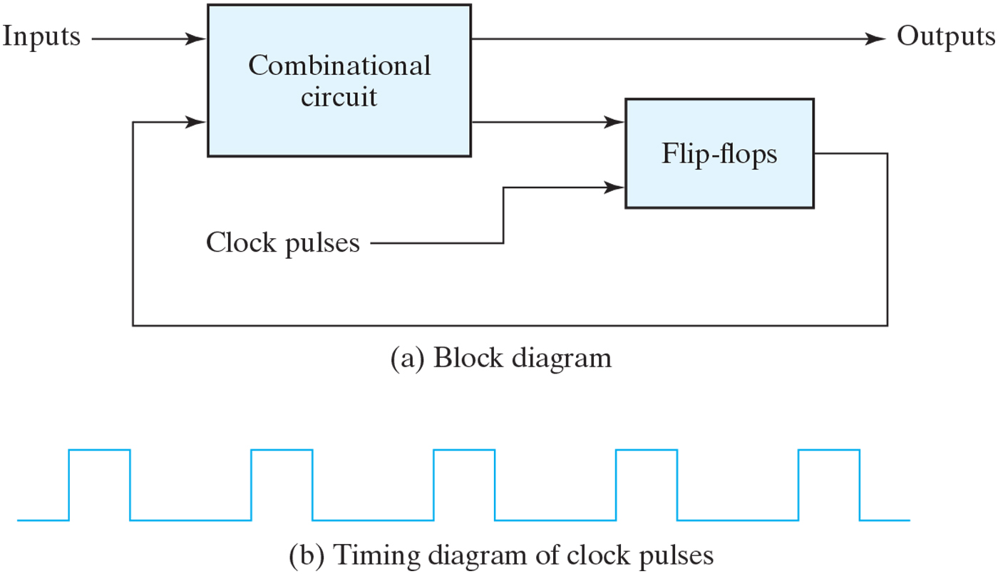
Synchronous clocked sequential circuit
Two types of sequential logic
Synchronous : behavior depends on the signals
affecting storage elements at discrete time
Asynchronous : behavior depends on inputs at any instance of time

Slide 4
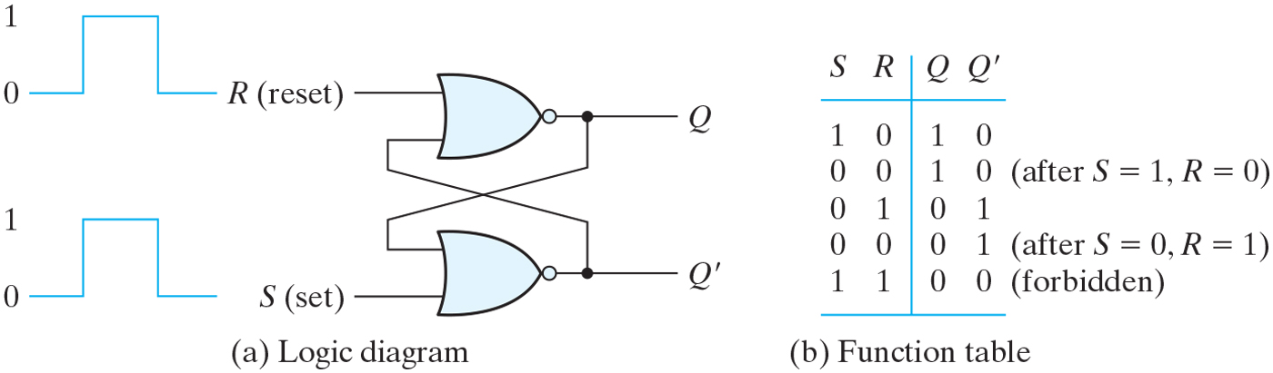
SR latch with NOR gates
S=1,R=0 then Q=1(set)
S=0,R=1 then Q=0(reset)
S=0,R=0 then no change(keep condition)
S=1,R=1 Q=Q′=0 (undefined)

Slide 5
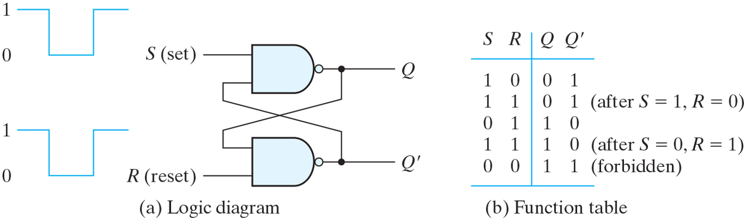
SR latch with NAND gates

Slide 6
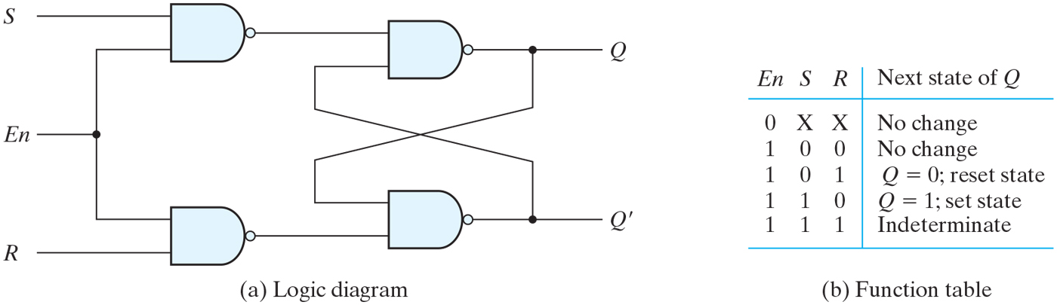
SR latch with control input

Slide 7
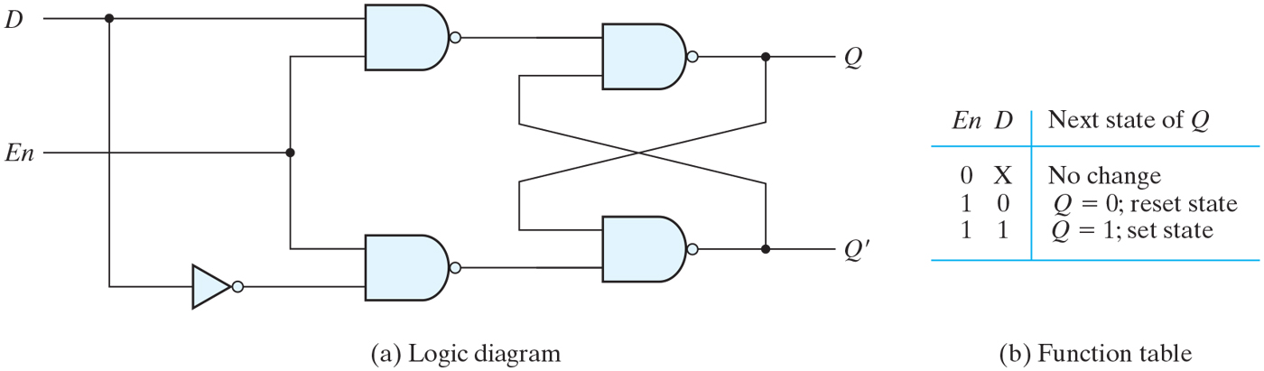
D latch

Slide 8
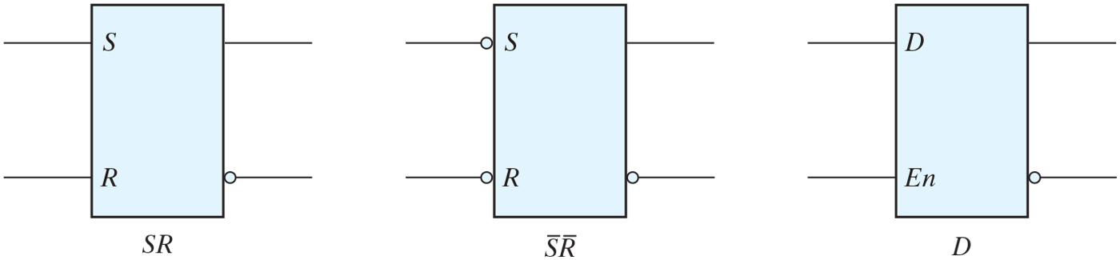
Graphic symbols for latches

Slide 9
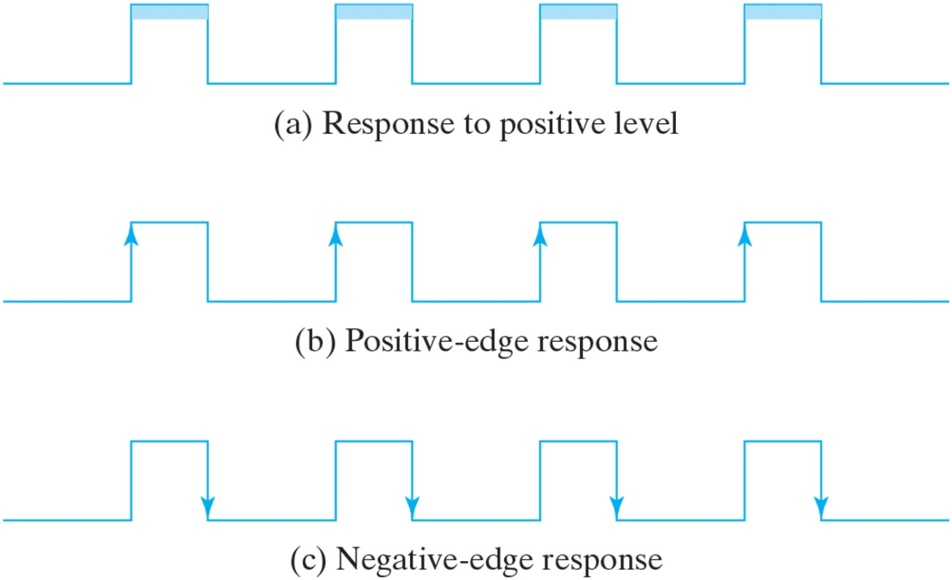
Clock response in latch and flip-flop
Latch : case (a), output changes as input changes
Flip-flop : output only changes at clock edge

Slide 10
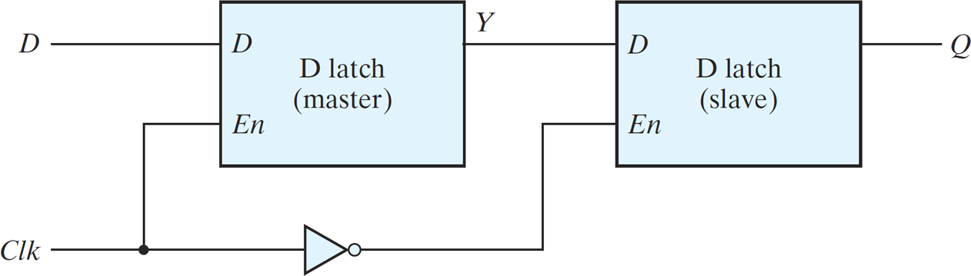
Master–slave D flip-flop
Negative edge triggered D flip-flop
Clk=0 : master disable, slave enable
Output has no relation with input
Clk=1 : master enable, slave disable

Slide 11
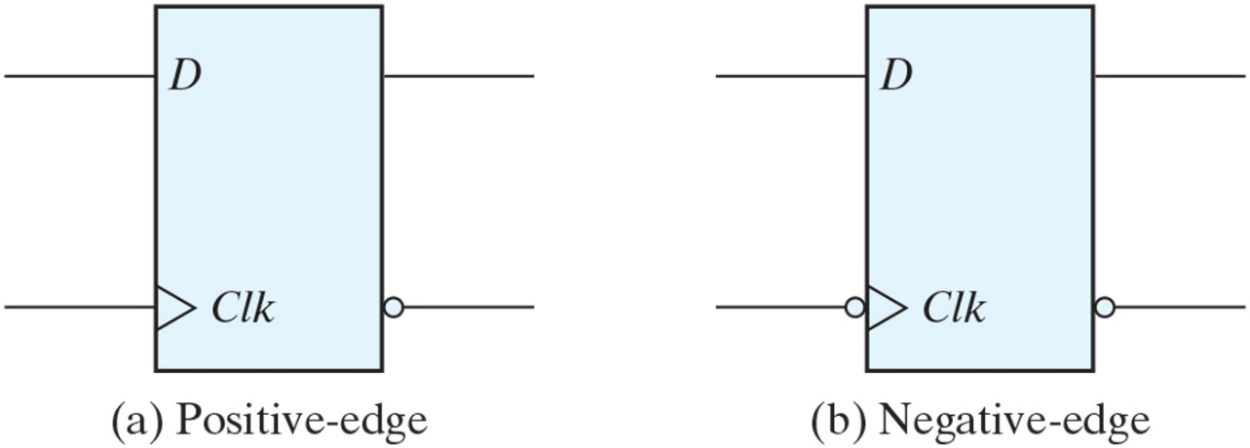
Graphic symbol for edge-triggered D flip-flop

Slide 12
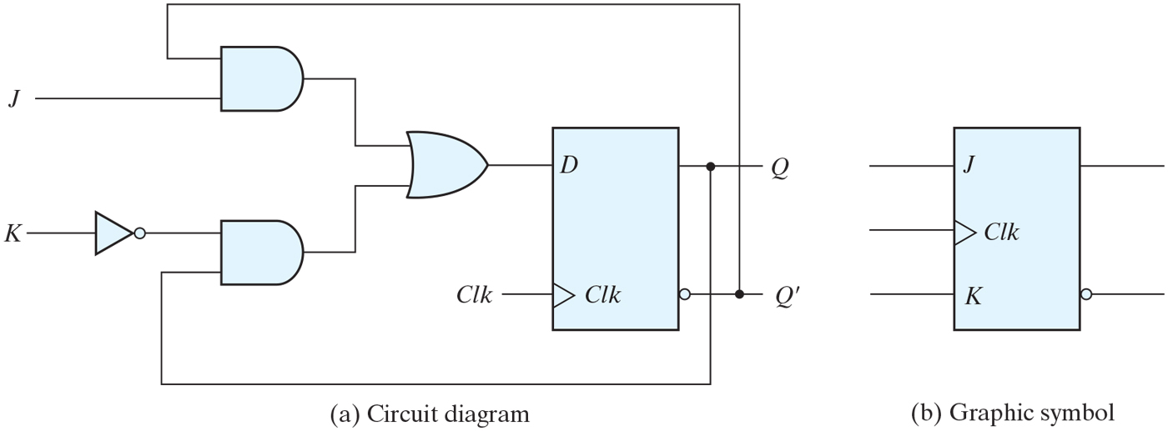
JK flip-flop
Set(J), Reset(K), Complement(J=K=1)
D=JQ′+K′Q

Slide 13
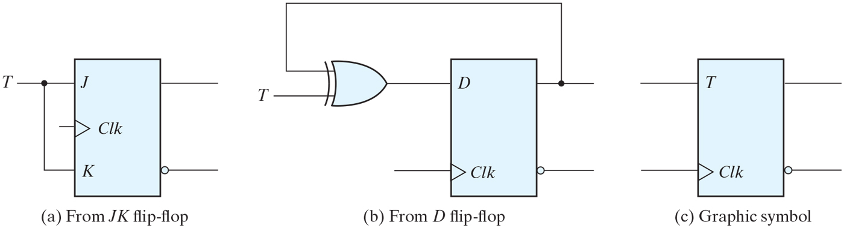
T flip-flop
Complementing flip-flop
D=TQ′+T′Q

Slide 14
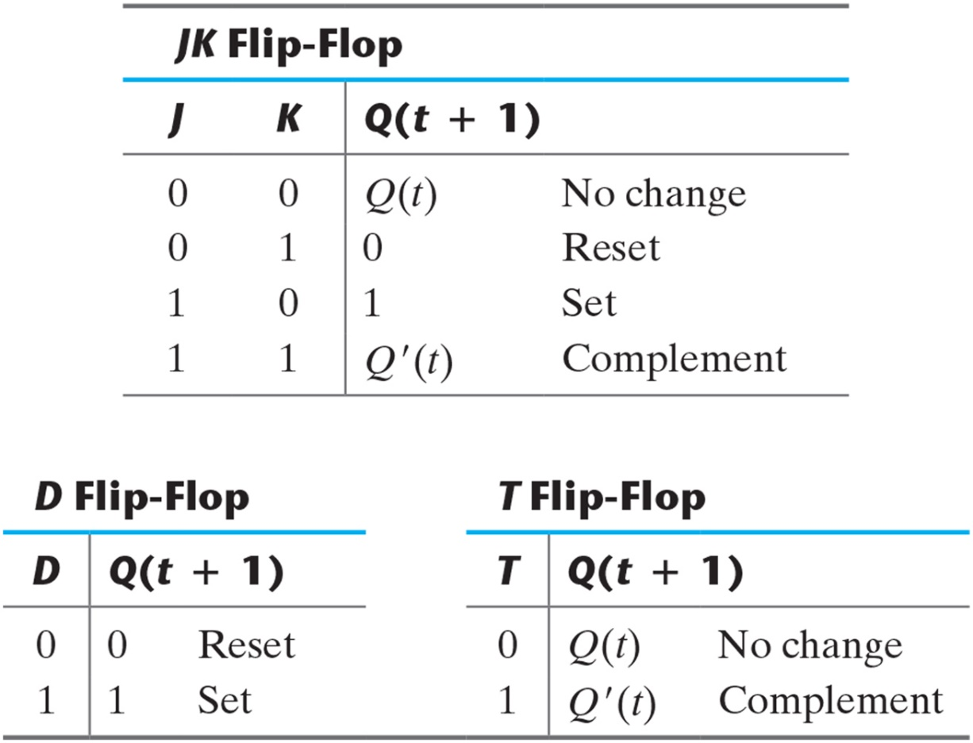
Flip-Flop Characteristic Tables

Slide 15
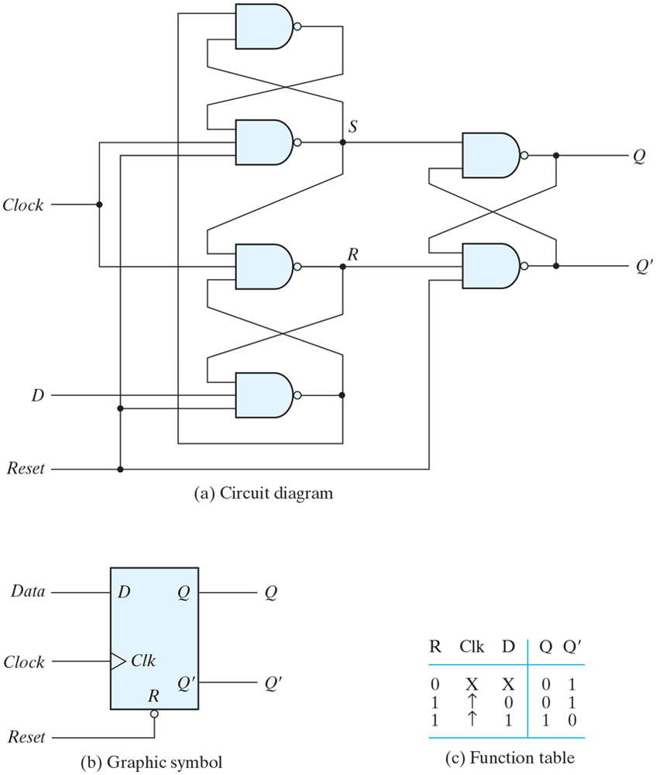
D flip-flop with asynchronous reset

Slide 16
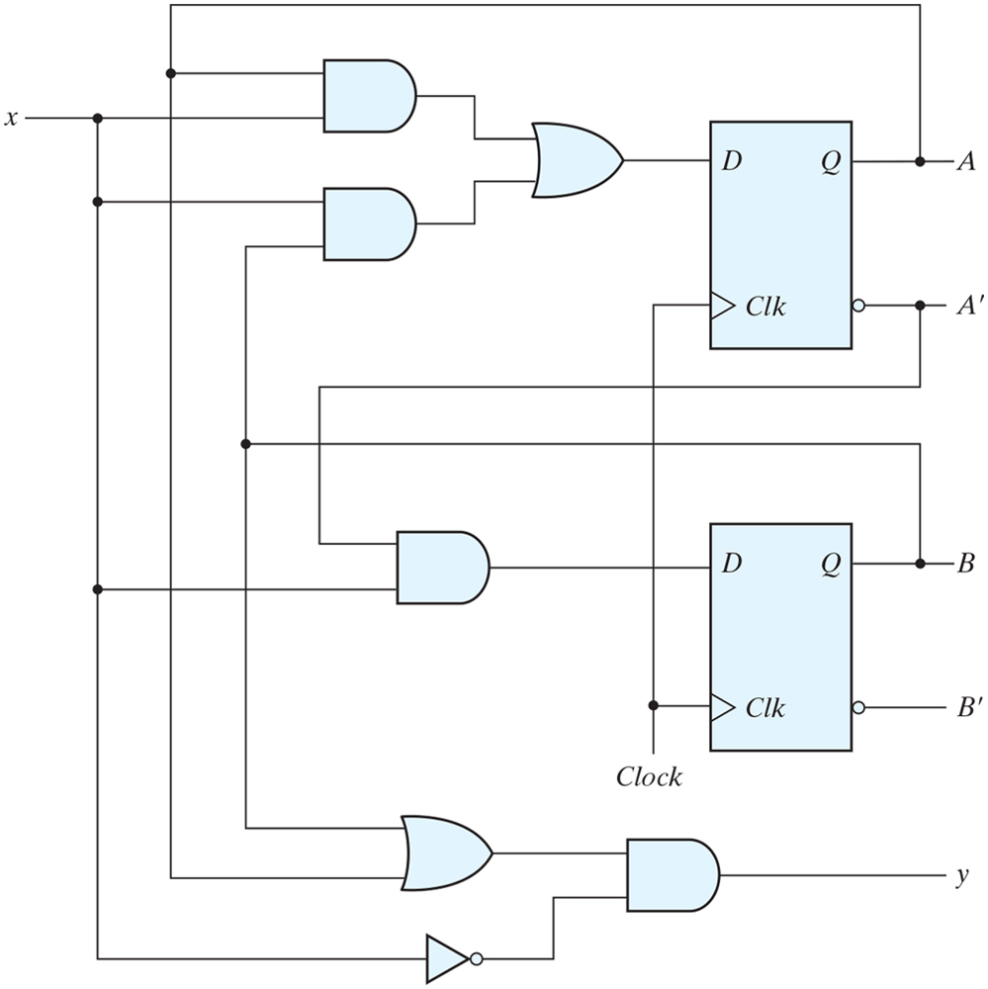
Example of sequential circuit

Slide 17
Analysis of clocked sequential circuit
Behavior of clocked sequential circuit is determined from input, output and present state
Outputs and next states are a function of inputs and present states

Slide 18
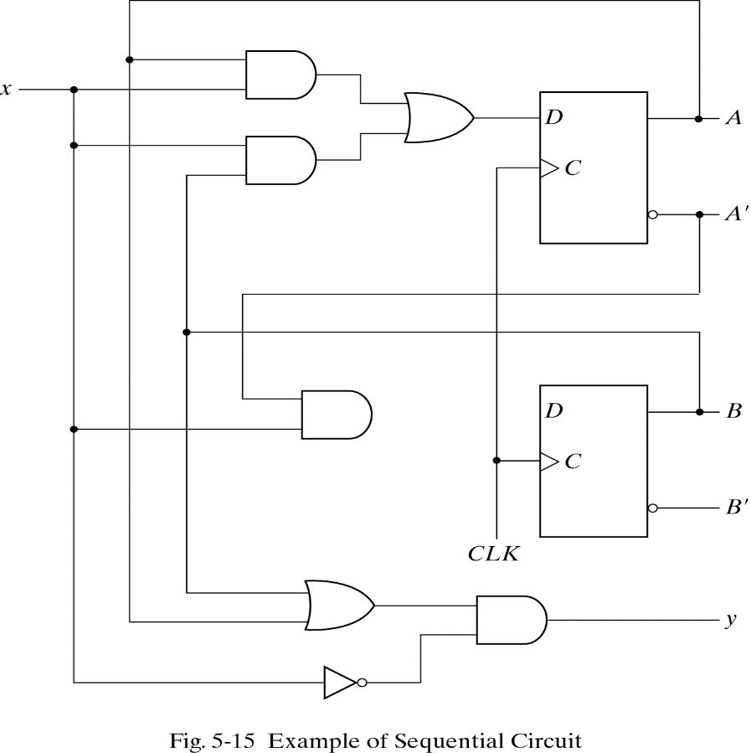
State Equations
Specifies the next state and output as a function of the present state and inputs
A(t+1)=Ax + Bx
B(t+1)=A′x
Y=(A+B)x′

Slide 19
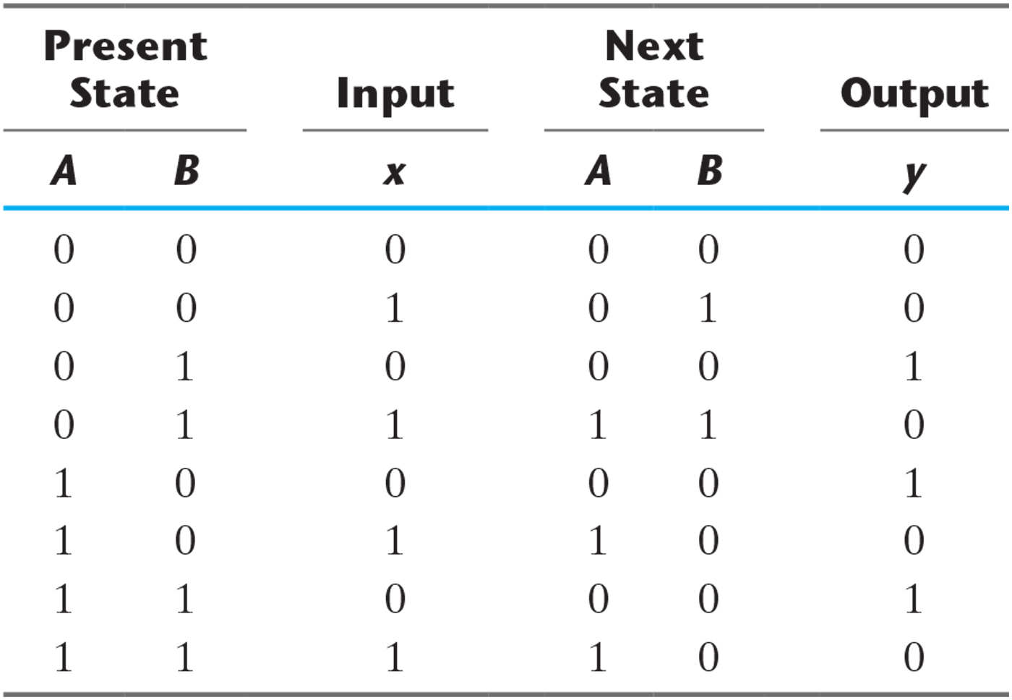
State Table for the Circuit of Fig. 5.15

Slide 20
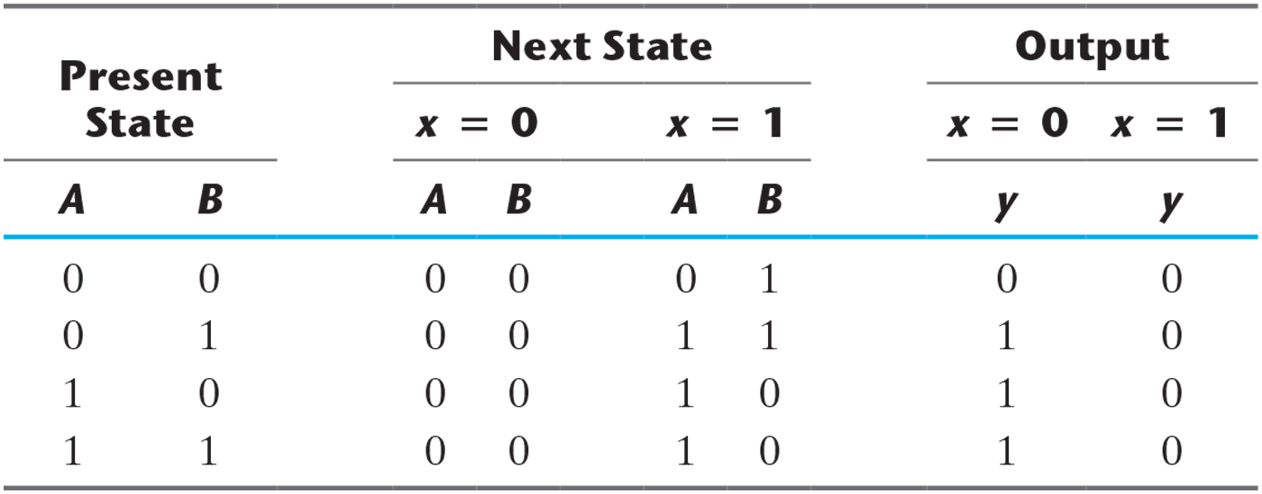
Second Form of the State Table

Slide 21
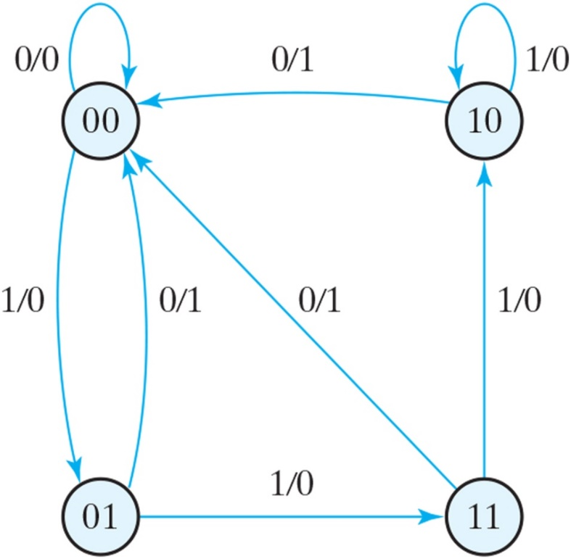
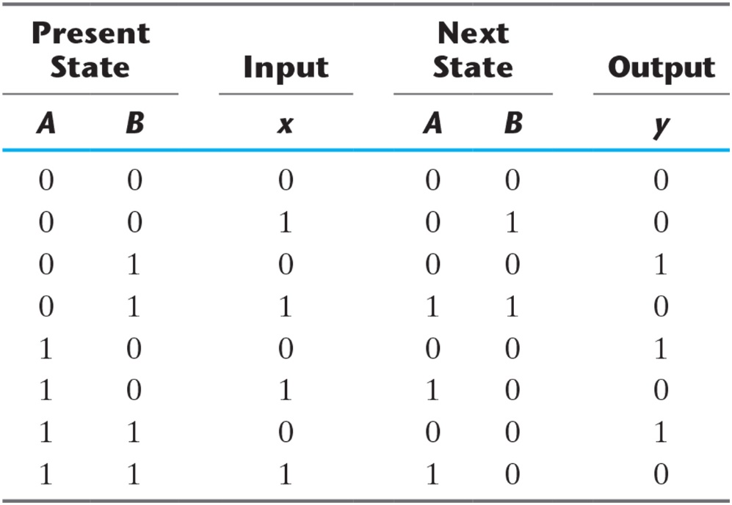
State diagram of the circuit of Fig. 5.15

Slide 22
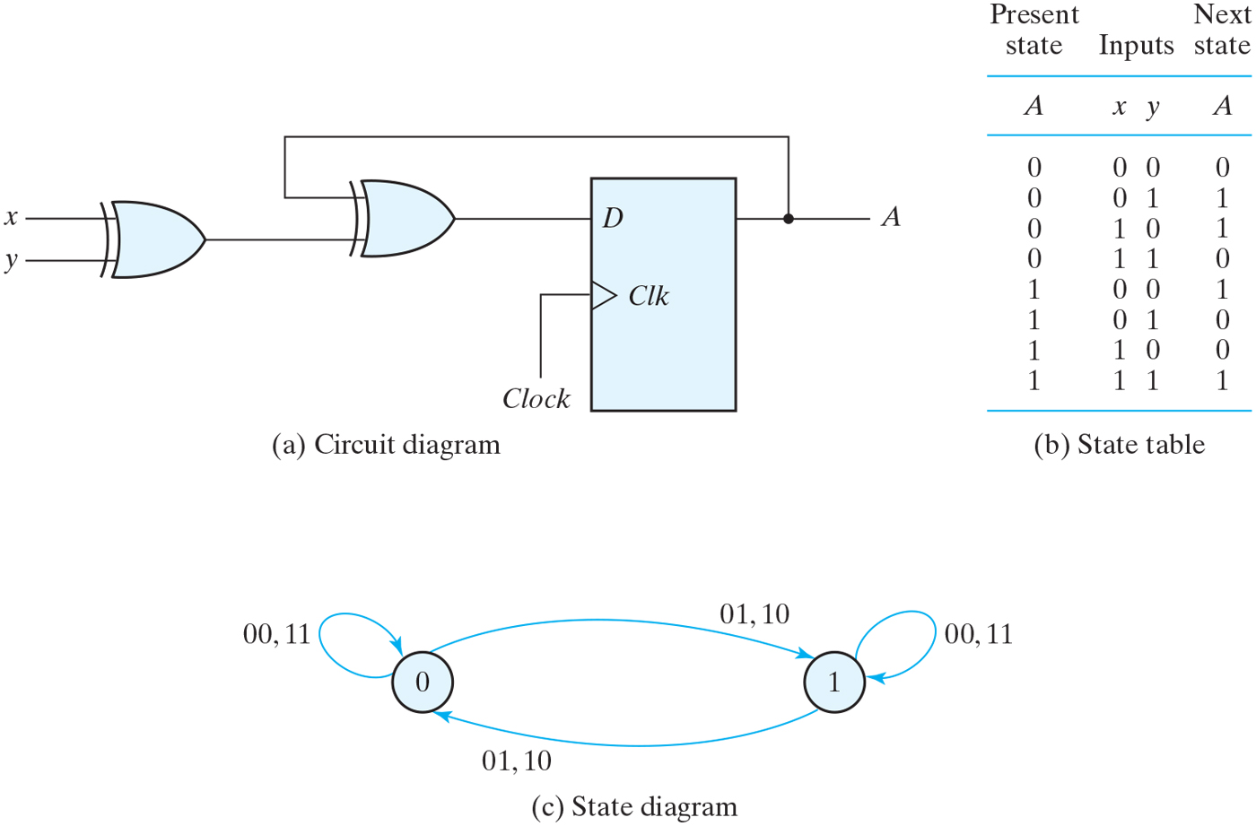
Sequential circuit with D flip-flop

Slide 23
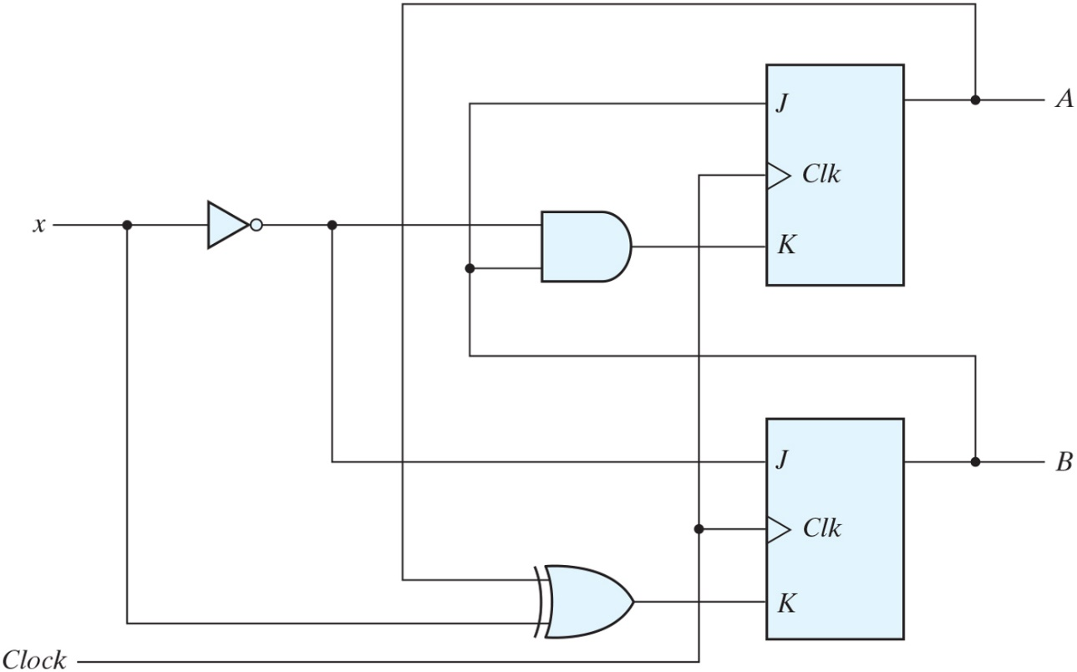
Sequential circuit with JK flip-flop
State equation is not the same as the input equation
Characteristic table or characteristic equation is needed
Input equations
JA=B KA=Bx′
JB=x′ KB=A′x+Ax′

Slide 24
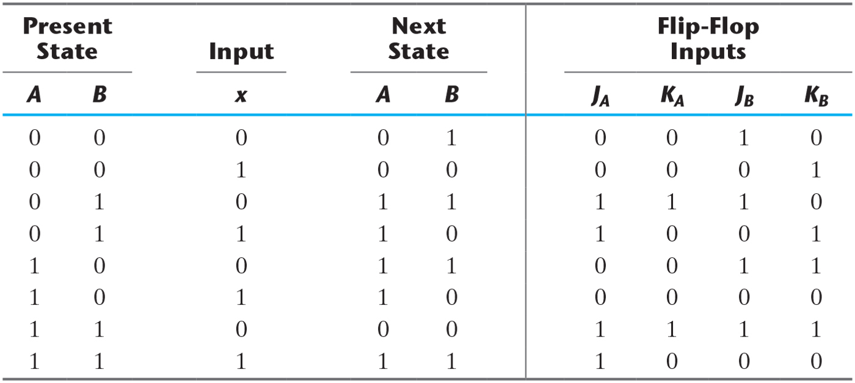
State Table for Sequential Circuit with JK Flip-Flops

Slide 25
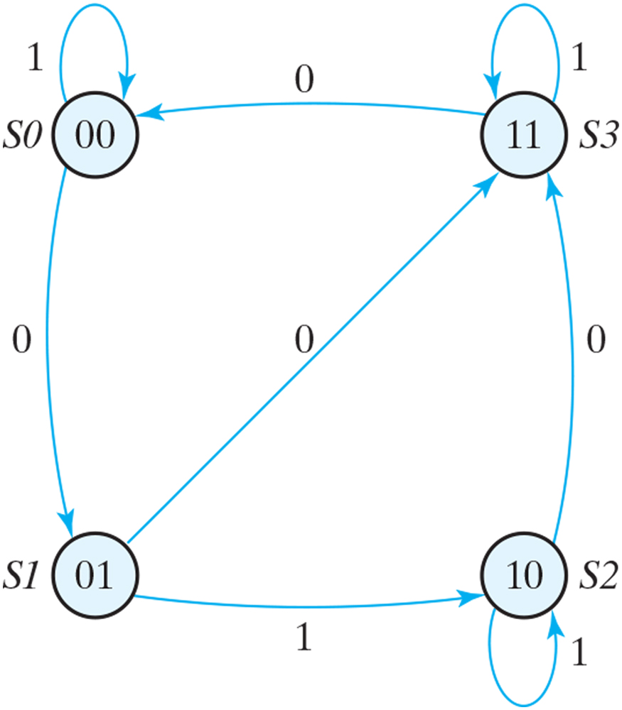
State diagram of the circuit of Fig. 5.18

Slide 26
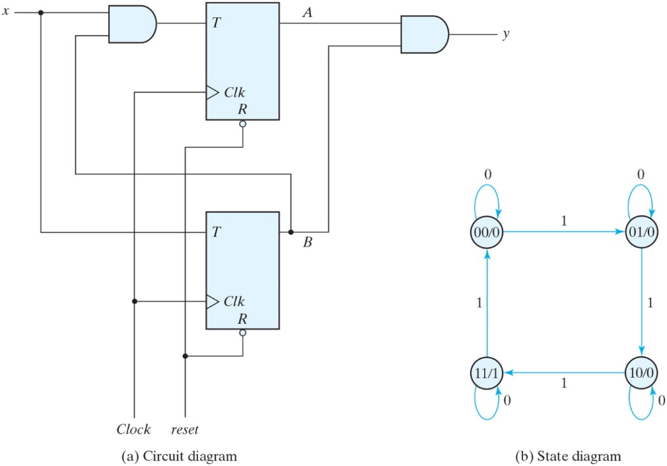
Sequential circuit with T flip-flops (Binary Counter)
Input equations and output equation
TA=Bx, TB=x
y=AB
State equations are derived from characteristic equation
A(t+1)=T_{A}A′+T_{A}′A
B(t+1)=T_{B}B′+T_{B}′B

Slide 27
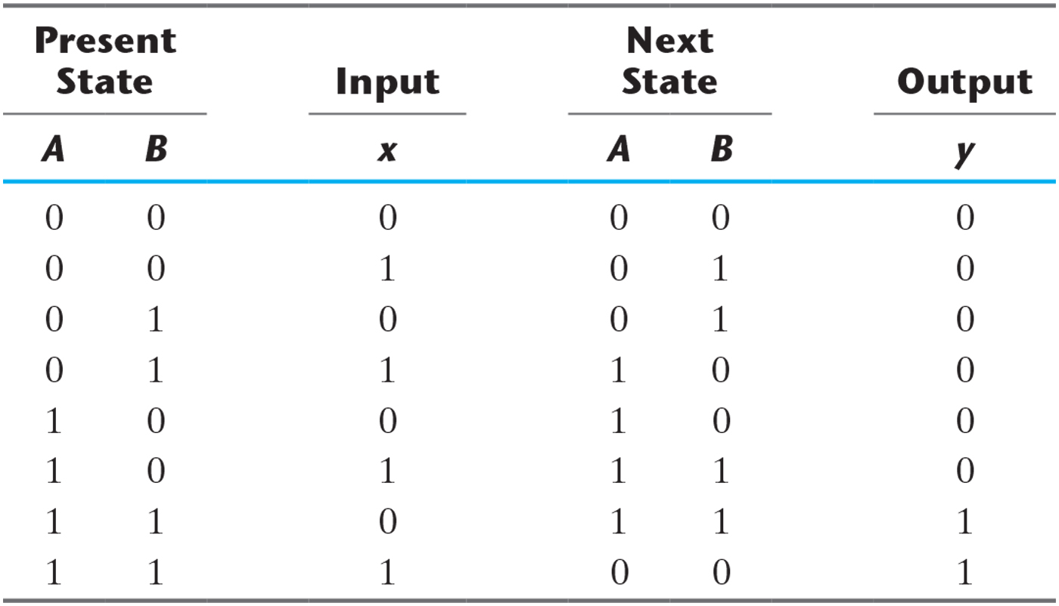
State Table for Sequential Circuit with T Flip-Flops

Slide 28
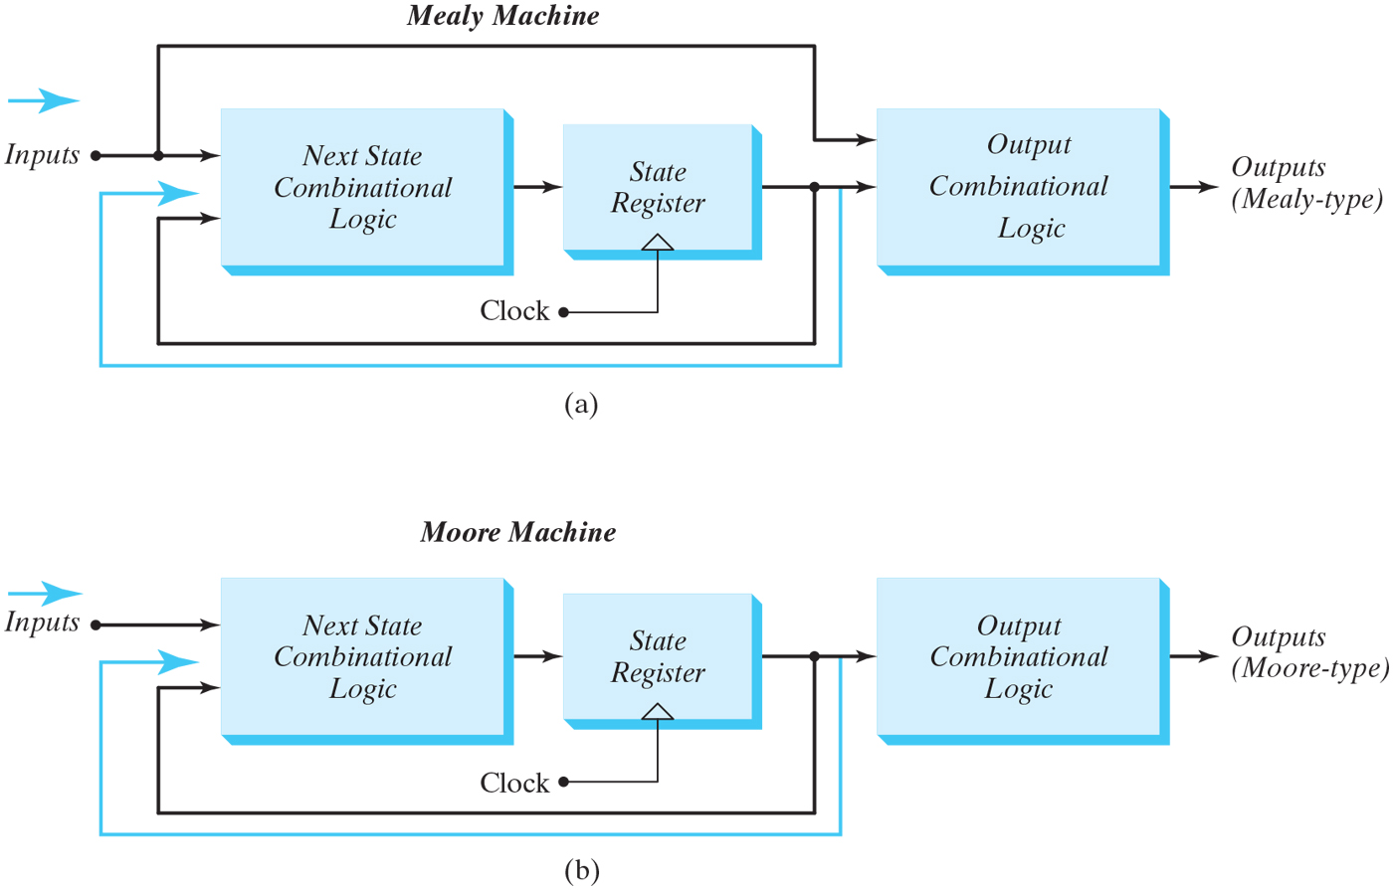
Block diagrams of Mealy and Moore state machines
Mealy model : output is a function of the present state and input
Inputs must be synchronized with the clock
Outputs must be sampled at the clock edge
Moore model : output is a function of the present state only

Slide 29
State Reduction
State reduction is used to reduce the number of flip-flop and gates
Only input/output sequences are important
Interested in present states that go to the same next state and have the same output

Slide 30
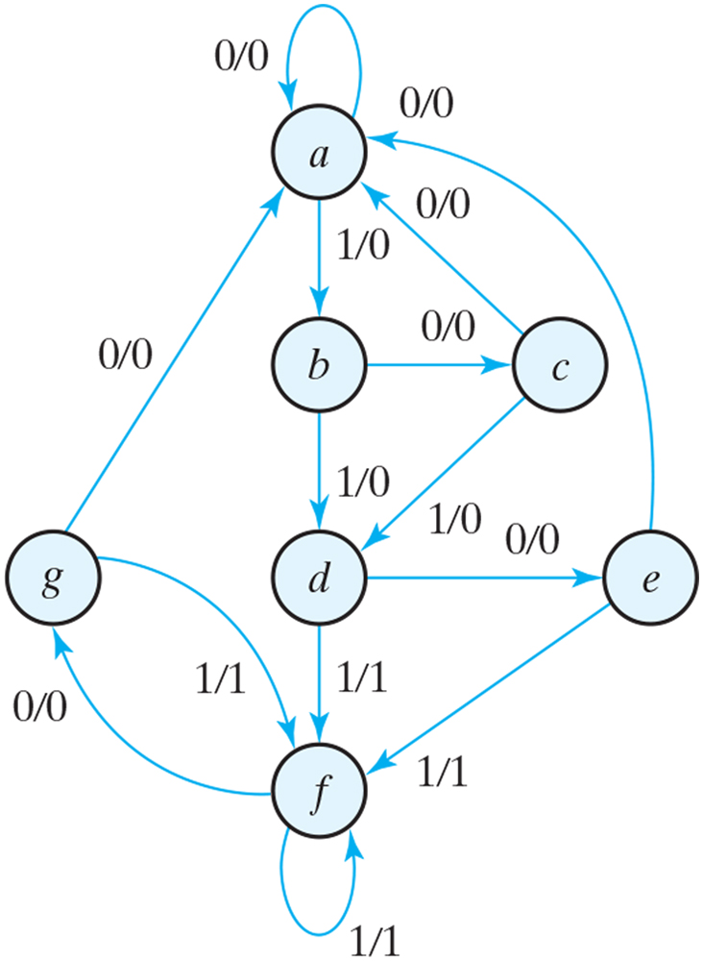
State diagram

Slide 31
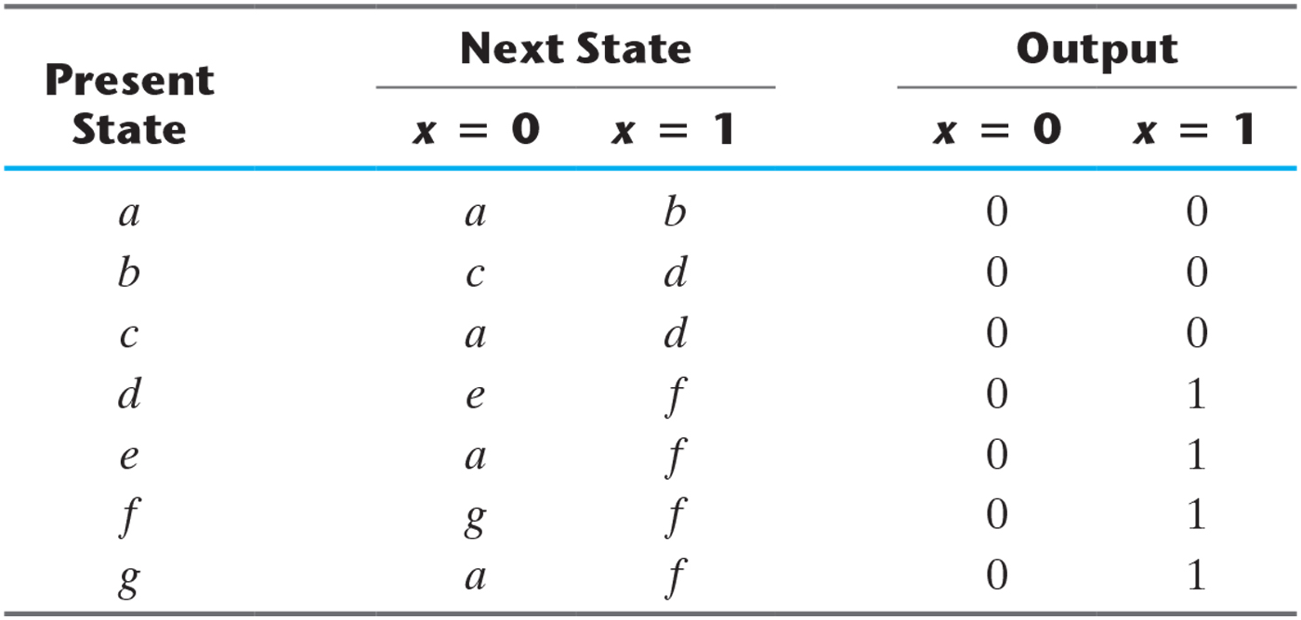
State Table

Slide 32
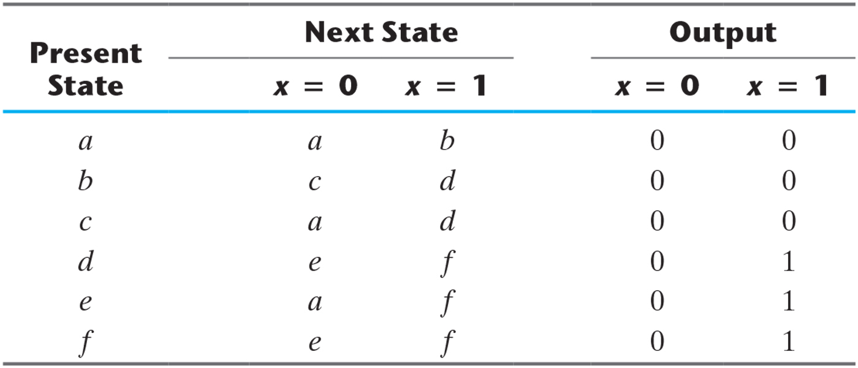
Reducing the State Table

Slide 33
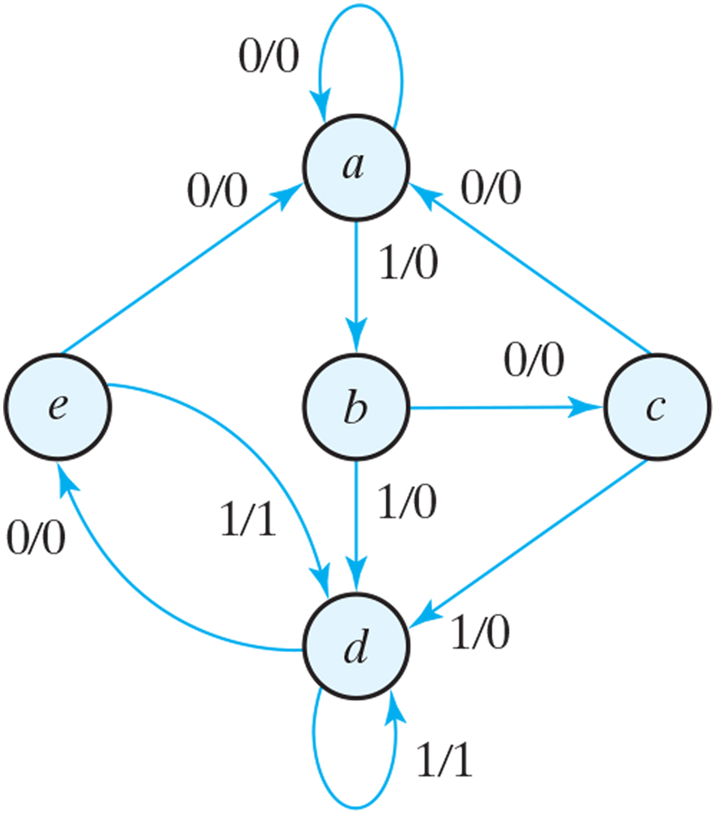
Reduced State diagram

Slide 34
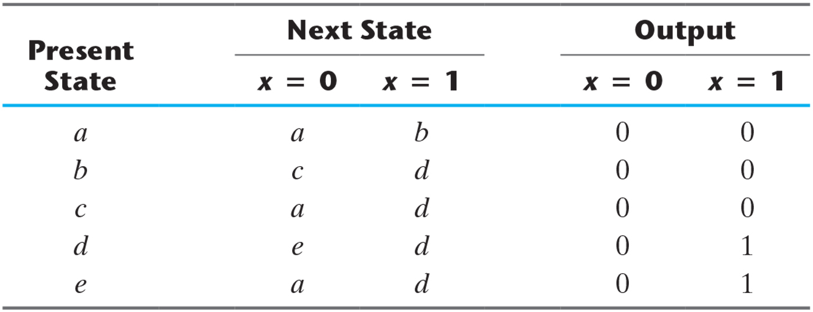
Reduced the State Table

Slide 35
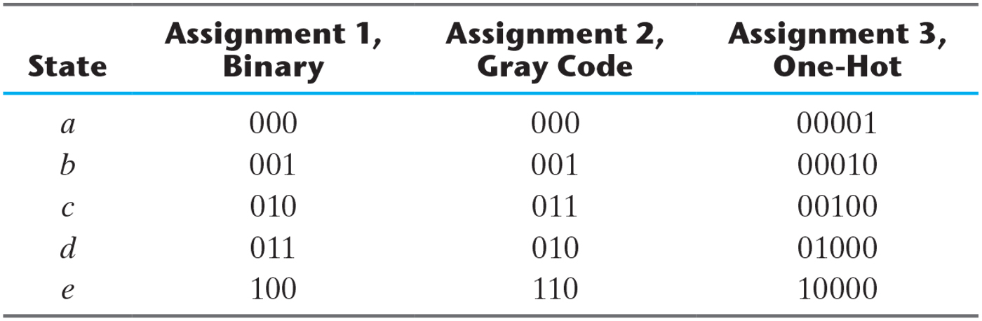
Three Possible Binary State Assignments
m states circuit, codes must contain n bits where 2ⁿ≥m
Three possible binary state assignments

Slide 36
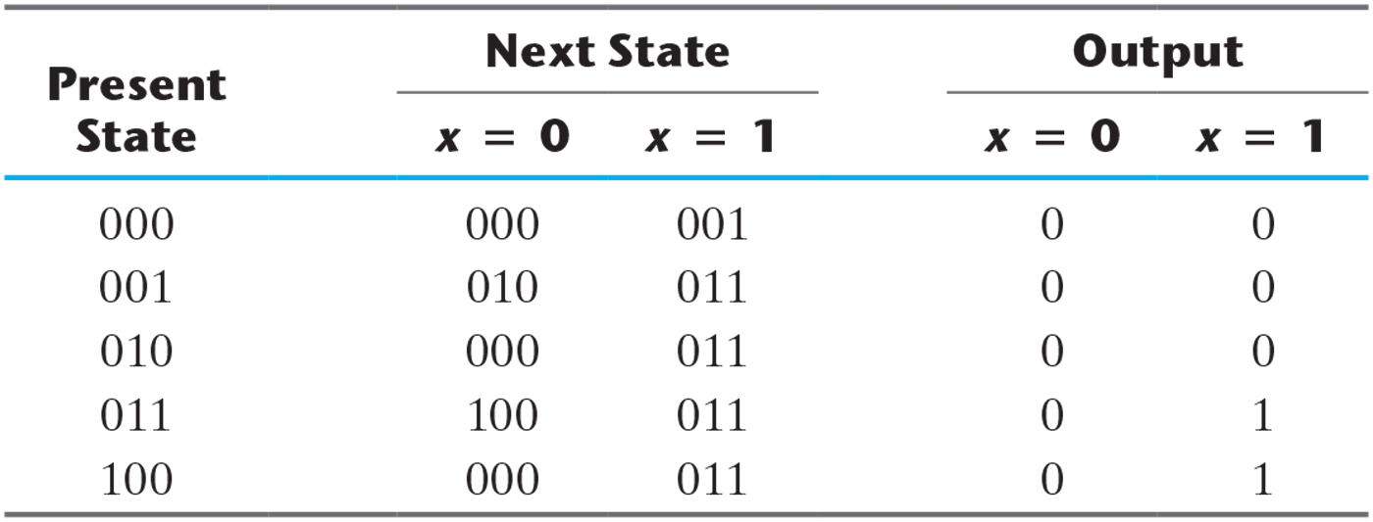
Reduced State Table with Binary Assignment 1

Slide 37
Design Procedure
Sequential circuit design : requires state table
⇔ Combinational circuit : truth table
The number of flip-flop is determined from the number of states
If 2ⁿ states exist, there are n flip-flops
Design steps
Derive a state diagram or state table
Reduce the number of states if necessary
Assign binary code to the state
Choose the type of flip-flops to be used
Derive the flip-flop input equations and output equations
Draw the logic diagram

Slide 38
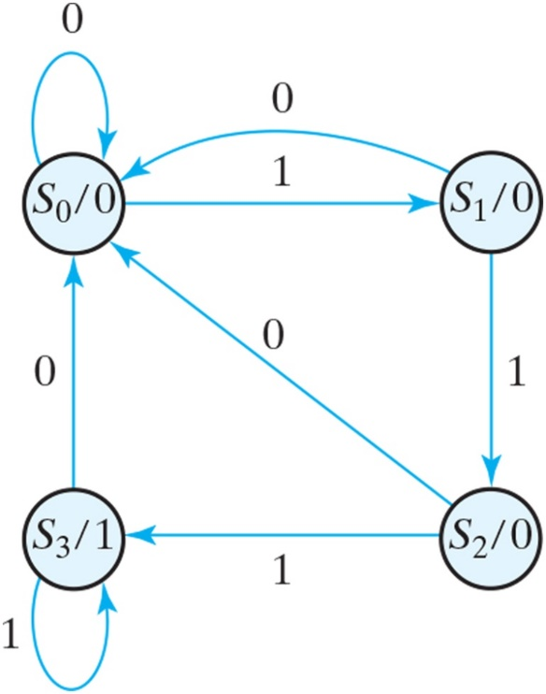
State diagram for sequence detector
Three or more consecutive 1’s in a string of bits coming through an input line

Slide 39
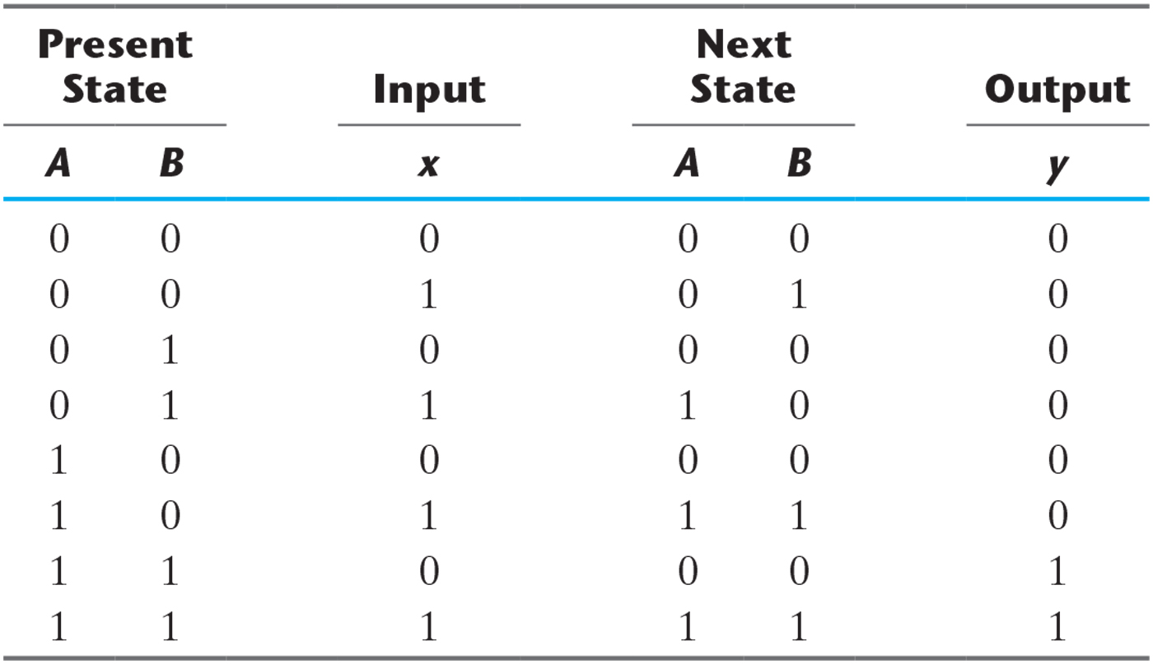
State Table for Sequence Detector

Slide 40
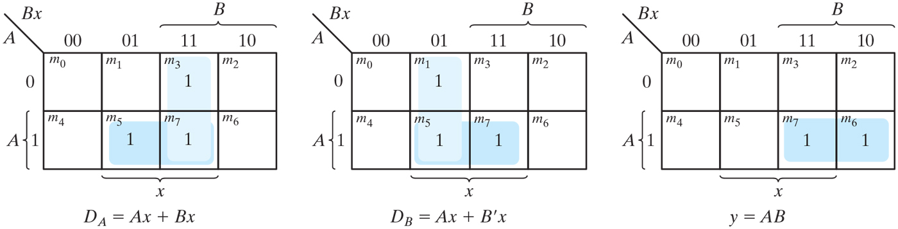
K-Maps for sequence detector

Slide 41
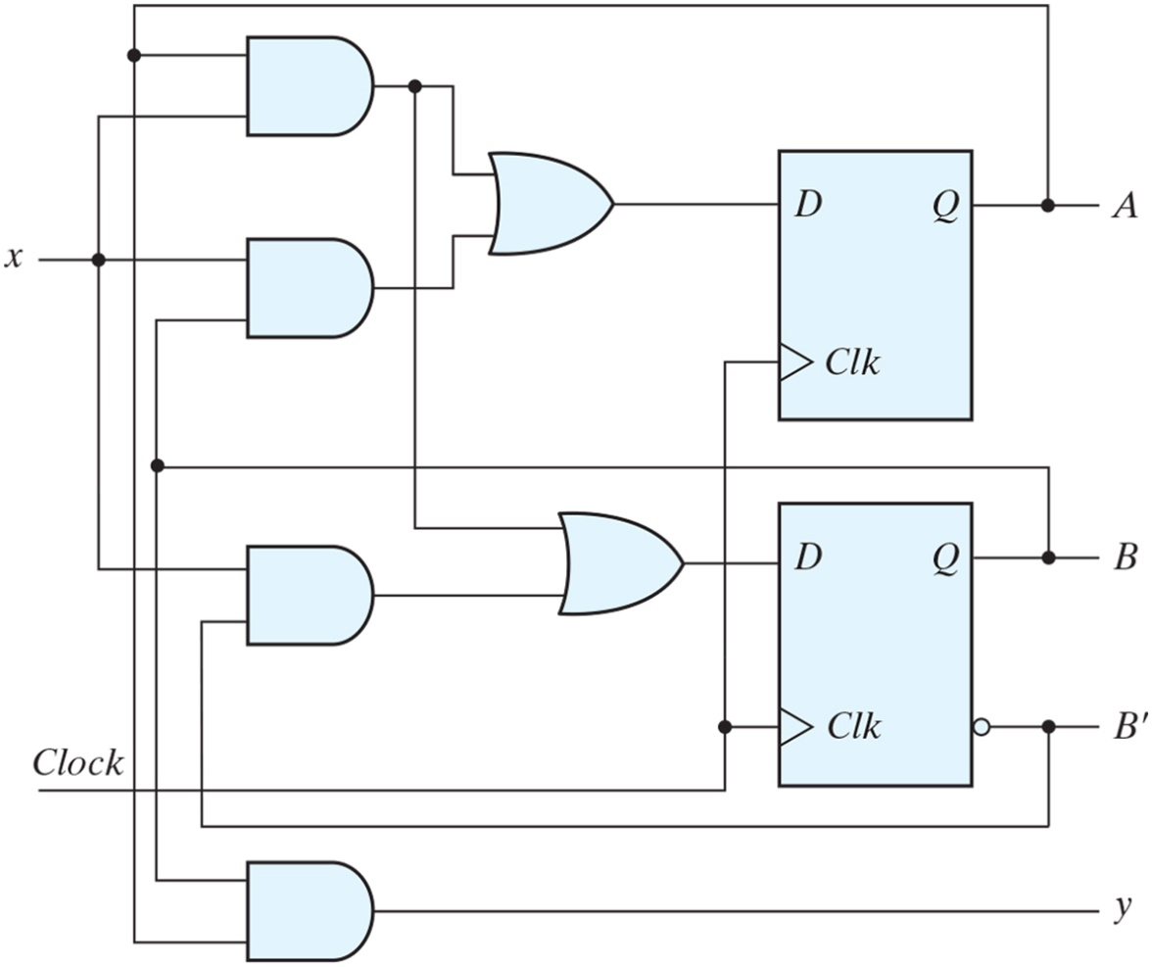
Logic diagram of a Moore-type sequence detector

Slide 42
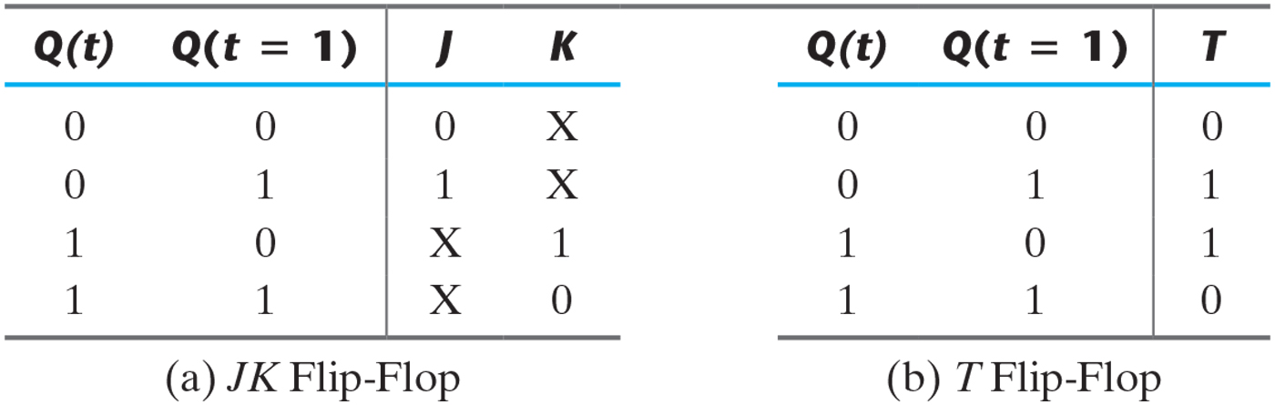
Flip-Flop Excitation Tables

Slide 43
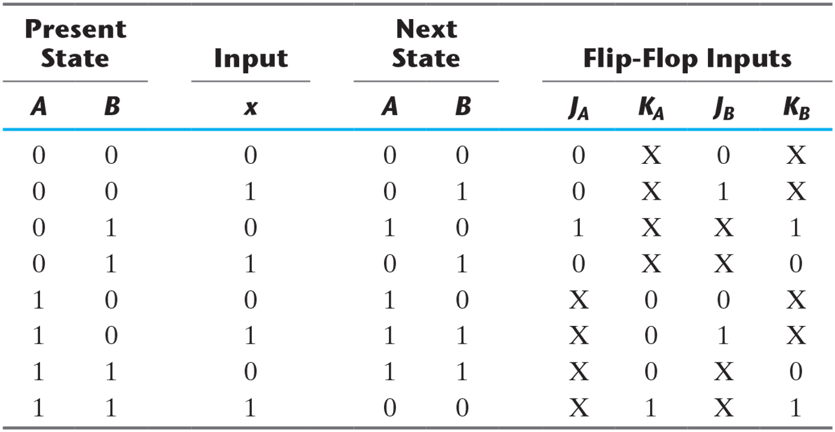
State Table and JK Flip-Flop Inputs

Slide 44
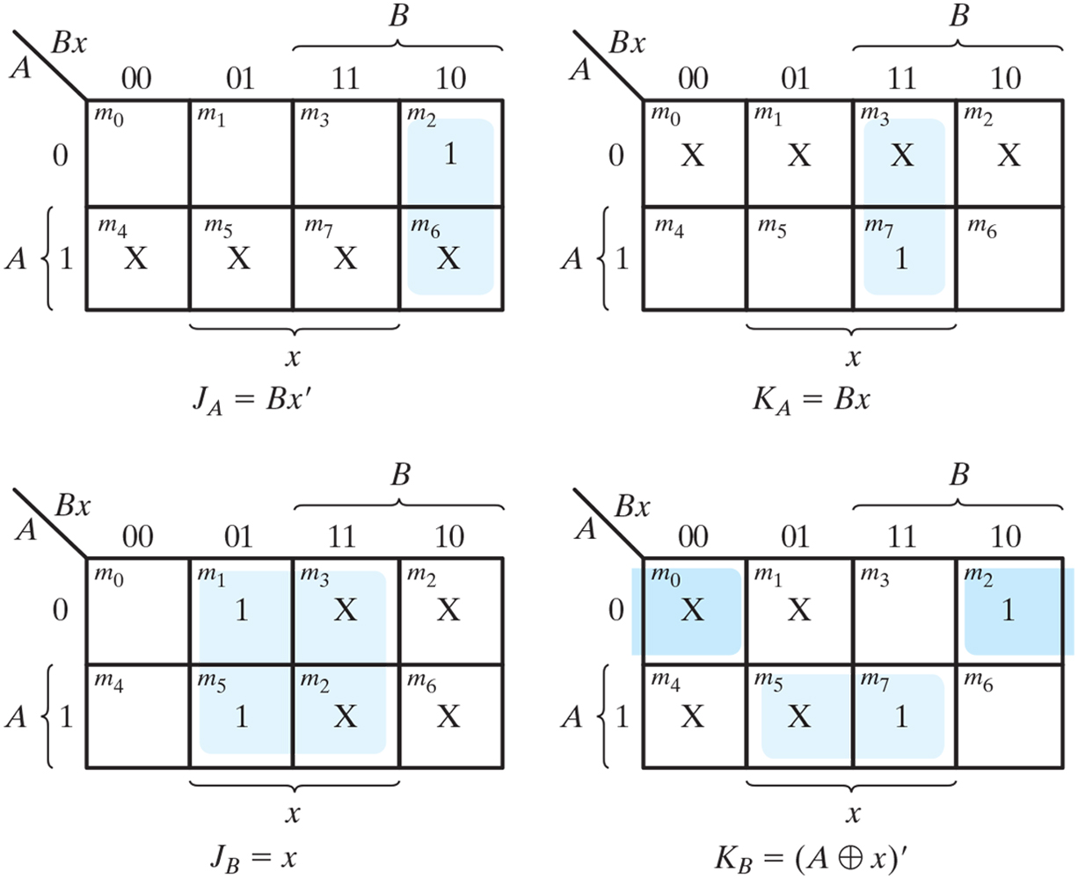
Maps for J and K input equations

Slide 45
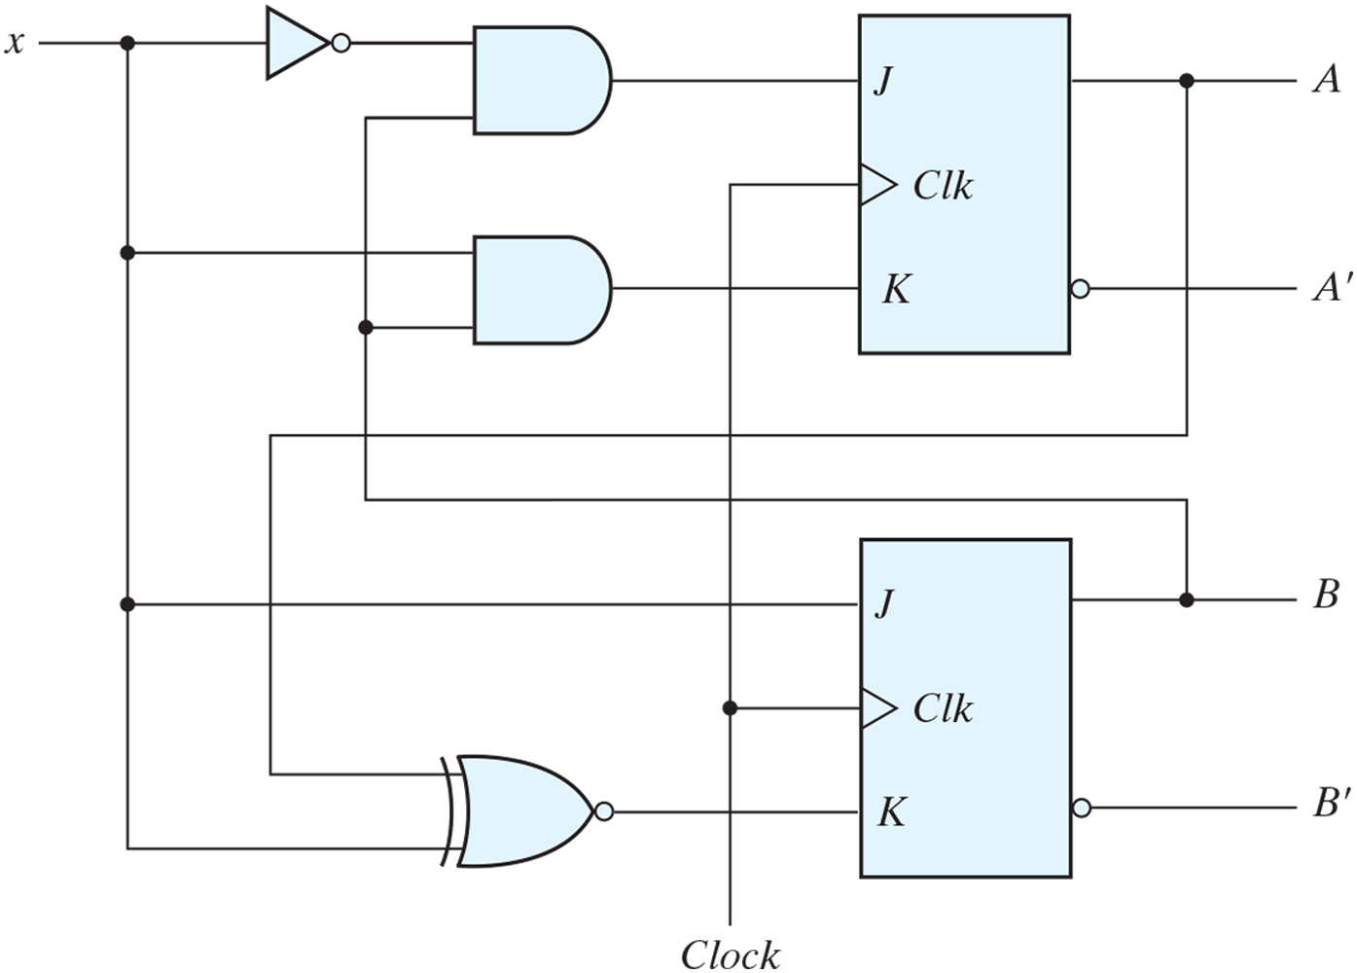
Logic diagram for sequential circuit with JK flip-flops

Slide 46
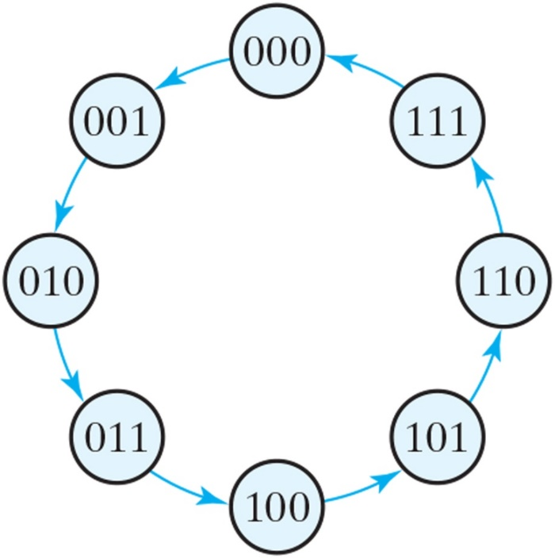
State diagram of three-bit binary counter
3-bit counter has 3 flip-flops and can count from 0 to 2ⁿ-1(n=3)

Slide 47
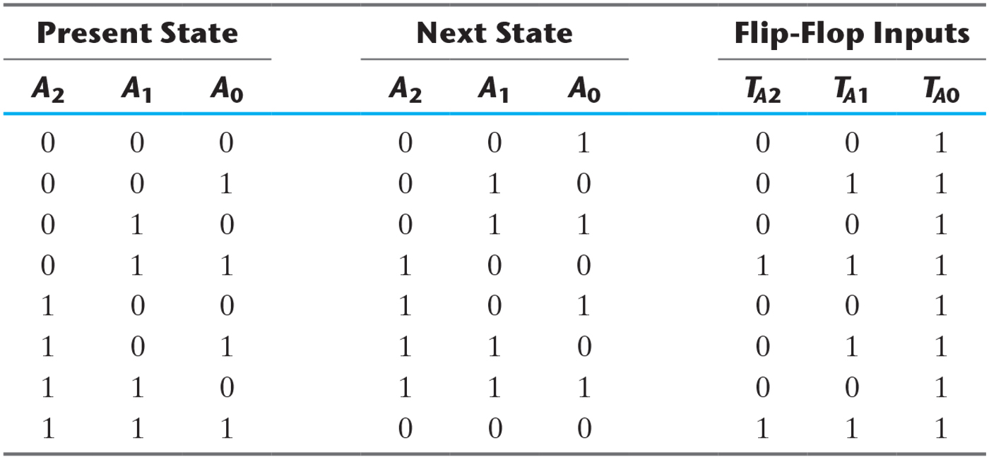
State Table for Three-Bit Counter

Slide 48
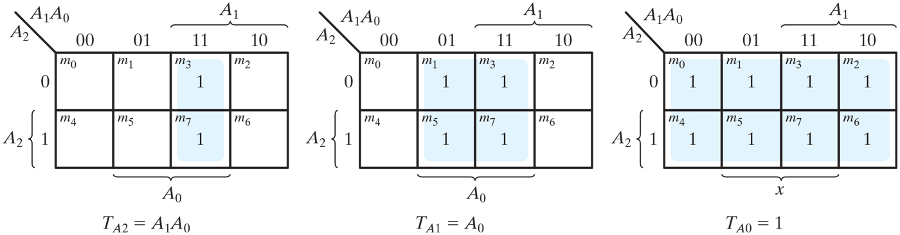
Maps for three-bit binary counter

Slide 49
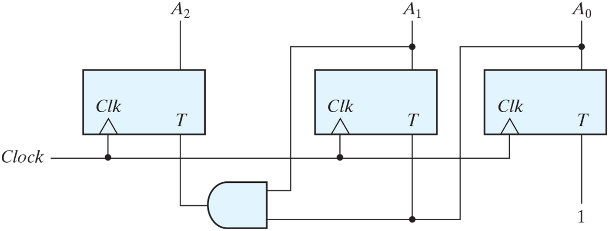
Logic diagram of three-bit binary counter

